Slide 1
HELPING HANDS
By:
Timnit Tesfatsion
Daniel Bae
Briana Jenkins
James Choi
Anusha Malla
Haythem Abdelkhalek

Slide 2
Objectives:
Meet the Group
System Request
Feasibility Analysis
Additional Comments
Kanbanflow
Questions

Slide 3
MEET THE GROUP!
Timnit Tesfatsion: Project Manager
overlook the overall project from start to finish
coordinate meeting times
each team member to meet deadlines and assign responsibilities.
Daniel Bae - Lead Programmer
oversee and code the basic structure of our app
code will encompass Java, HTML, and SQL code with the possibility of additional languages.
Briana Jenkins: System Design Analyst
takes the both jobs of a system analyst and a programmer analyst.
will be designing the design layout for the app
android studio software will be used

Slide 4
MEET THE GROUP
Wonjin(James) Choi: QA/Business Systems Analyst
ensure software is implemented with the requirements needed
conduct analysis to create long term business solution.
Anusha Malla - QA
manually testing the app and the codes to prevent malfunctioning code or app.
Haythem Abdelkhalek: Database Developer
design a fully functional SQL-PL/SQL database with functions, procedures, and triggers that will be the base of the App.

Slide 5
System Request
Project Sponsor: Ira Fabri
Title:Supervisor of the Tutoring Program at UMBC
App need
this app will be developed in order to provide tutoring facilities to students via mobile app by scheduling their tutor through an app
eliminate long process of scheduling system
App requirement
students will be able to find their tutor according to their subject need and,
be able to schedule tutors based on availability and need
supervisors can add/remove tutors
a messaging system within the app for chatting b/n tutor and student

Slide 6
System Request
App value
Help students to have an easy access to their tutor
Flexibility of schedule
Low cost
Efficiency
Long-term benefits
Special issues or Constraints
In order to facilitate students with better tutoring environment this app needs to be completed as soon as possible.
Competition with other apps that are already in the market

Slide 7

Technical Feasibility
Familiarity
Medium risk, many have worked on sql but only one member worked on apps.
Low risk for familiarity since the current system is being used.
Project size
Will take 3-5 months
Low risk because it’ll be slowly implemented. Not a massive project.
Medium to high risk with how the UMBC system will integrate with the tutoring as well as managing the system.
Compatibility
Low Risk : Have to rely on data by manual implementations… StudyTree may not provide existing data, but the data is somewhat public. Once data is inserted the system will work fine.
Low Risk since system can run by itself when data is implemented.

Slide 8
Economical Feasibility
(Based on cost-benefit analysis calculations)
The estimations shows that Helping Hands App will increase UMBC’s performance in its tutoring system.
ROI over 12 months: 70%
NPV over 12 months: $6991
Break-even occurs after 1.26 years
What are the economical benefits of our app?
Elevated customer satisfaction which would increase application purchase
Lower cost maintaining local app
Increase in the number of students who may not know about this service, potentially increasing revenue
Chance for competition and expansion of app to other universities
Create jobs for students and other staff members

Slide 9
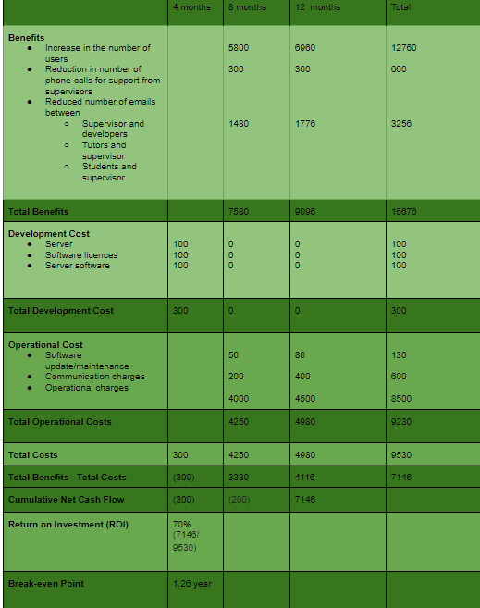

Cost-Benefit Analysis - Simple Cash Flow Method

Slide 10
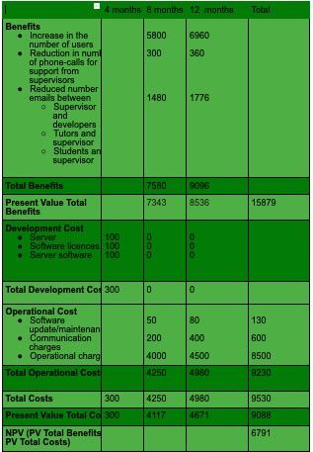
Cost-Benefit Analysis - Discount Cash Flow Method:

Slide 11
Organizational Feasibility
What kind of risk does this app pose to umbc?
It can pose a low risk if the supervisor is liking the idea and thinks it can be beneficial
It can pose as high risk if they think they already have an alternative option and thinks it will be a little use to them
Does the supervisor of our project have interest? What kind? Expectations?
Supervisor needs faster support for schedule changes.
They need instant ability to add new tutors to the system.
What kind of reaction/feedback are we expecting from the feature user of our app? What about the concerns they might have? Challenges/competitions?
That it would be easier for the students to operate when wanting to schedule or reschedule for tutoring
It would become easier for the students to be able to cancel, update or stay in contact with tutors
Having the ability to use the app easily
Make it easier for them so that they can talk to friends about the app and then we can get many more students to use it more often

Slide 12
Feasibility: Additional Comments
Profitable
easy access for all students/tutors/supervisors
Allows for time flexibility
Faster communication/easier scheduling process
Attract students because of its easy scheduling system
Challenges:
The coding might be a little tricky
Getting all of the universities to buy the app might take some time

Slide 13
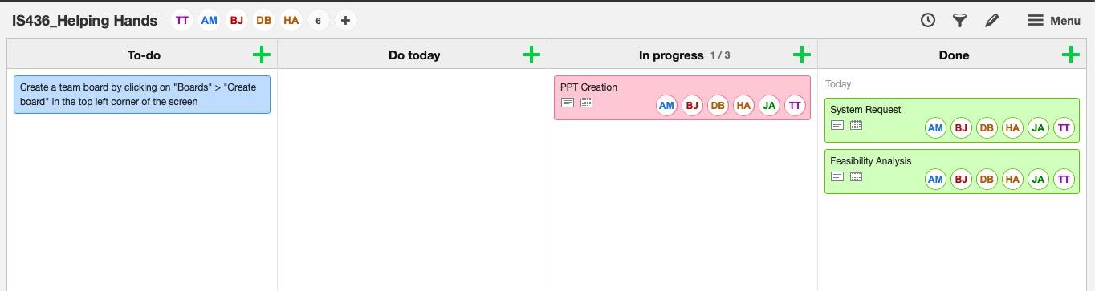
KanbanFlow

Slide 14
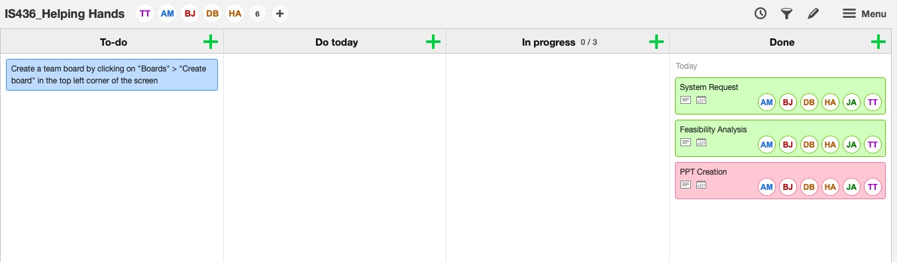
KanbanFlow

Slide 15
Summary
Meet the Group
System Request
Feasibility Analysis
Additional Comments
Kanbanflow

Slide 16

QUESTIONS????

